Slide 1

Spoiled Beverage Detector
Jahangir Esfandiari (ID: 217834)
Bahar Rahmani (ID: 218192)
Kymbat Talant (ID: 203235)
Vanessa Mathew (ID: 217957)

Slide 2
Outline
Introduction/Objective
Early Findings (Properties of Fruit Juices and Milk)
Current Technologies
Functions and structures
Possible Solutions : Option 1 (Gas sensor)
Possible Solutions : Option 2 (pH meter)
Complete design status
Demonstration
Evaluation/Conclusion

Slide 3
Introduction/Objective
Consuming Expired Drinks
Effect: Stomach cramp, fever, vomiting, nausea, diarrhea, etc
Detecting spoilage takes time
Children not aware of the early signs of expired drinks
Objective: Smart cup to detect expired drinks and display accurate results fast.

Slide 4
Early Findings: Fruit Juices Property
Fruit juices have pH in the acidic range (<4.5) serving as important barrier for microbial growth
Freshly squeezed juice, is highly susceptible to spoilage more than whole fruit
Juices | pH range | Mean
Orange | 4.19–4.50 | 4.34
Sweet lime | 4.70–5.47 | 5.08
Carrot | 5.76–6.03 | 5.89
Table 1: PH level of different fruit juices [4]
Notes:
Source: Alicyclobacillus spp. Control in the Fruit Juice Industry
Microbiology of soft drinks and fruit juices (P. Wareing and R.R.) Davenport
-Unprotected by skin or cell walls, fluid components are thoroughly mixed with air and microorganisms from the environment.

Slide 5
Early Findings: Critical factors affecting the spoilage of juices
Intrinsic | Extrinsic
Juice pH | Storage temperatures and times
Water activity | Relative humidity conditions during storage and packaging material characteristics.
Table 2: Intrinsic & Extrinsic Properties for Juice Spoilage [5]
Effects:
Development of off-flavors
CO2 production
Changes in color, texture, and appearance
Notes:
Source: Microbiology of soft drinks and fruit juices (P. Wareing and R.R.) Davenport

Slide 6
Early Findings: Composition of cow‘s milk
The pH value of normal milk is in the range between 6.6-6.8 at 25°C
Main constituent | Limits of variation | Mean value
Water | 85.5 – 89.5 | 87.5
Total solids | 10.5 – 14.5 | 13.0
Fat | 2.5 – 6.0 | 3.9
Proteins | 2.9 – 5.0 | 3.4
Lactose | 3.6 – 5.5 | 4.8
Minerals | 0.6 – 0.9 | 0.8
Table 3: Quantitative composition of milk [6]

Slide 7
Early Findings: Different milk properties
Raw Milk | A wide variety of germs
Pasteurized Milk | Coxiella burnetti, Poreformers, Listeria Monocytogenes, Coliforms.
Condensed Milk | Glaucus, Aspergillus repens, Torulopsis.
Dried Milk | Bacillus, Micrococcus, Mucor
Table 4: Milk forms [7]

Slide 8
Early Findings: Fruit Juices + Milk Microorganisms
Microorganisms in spoiled fruit juices
Yeasts
Bacteria
Molds
Mycotoxins
Pathogens
Fruit juices contain a microflora which is normally present on the surface of fruits during harvest and postharvest processing which include transport, storage, and processing.
Common pathogens/bacteria seen both in milk and juice: Salmonella, E. coli., Pseudomonas
Notes:
Source: - Emerging Preservation Techniques for Controlling Spoilage and Pathogenic Microorganisms in Fruit Juices
Microbes Associated with Freshly Prepared Juices of Citrus and Carrots
However, food borne pathogens such as E. coli and Salmonella survive in acidic environment of fruit juices due to acid stress response

Slide 9
Motivation for detecting spoiled milk
Easier to sense spoiled milk than spoiled juices (wide range of pH value)
Important nutrients for humans as wells as for animals
Good milk wastage
Health issues in third world countries
Human senses are often inadequate
Solution: Smart sensing ph-system to make on time descisions

Slide 10
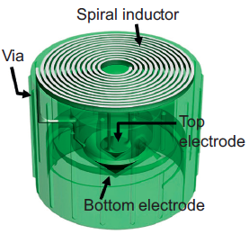
Current Technologies: Smart Cap
Sensing the quality of liquid in fluidic package
Based on changes in capacitance
Resonance frequency shifts of the LC tank via an inductive reader
LC tank as wireless-resonant sensor
Passive operation without power consumption
Fig.1. Design of a wireless “smart cap” [1]

Slide 11
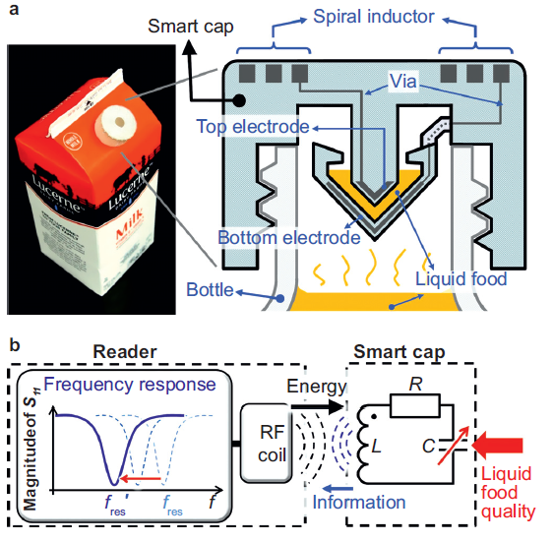
Current Technologies: Smart Cap (Design)
LC resonant circuit
Fig.2. (a) smart cap with milk package, (b) LC circuit diagram [1]
Notes:
By flipping the food package upside down. the liquid food is trapped inside the capacitor gap of the LC tank and acts as the dielectric
material. The LC tank’s fres, is determined by the dielectric constant of the liquid food.

Slide 12
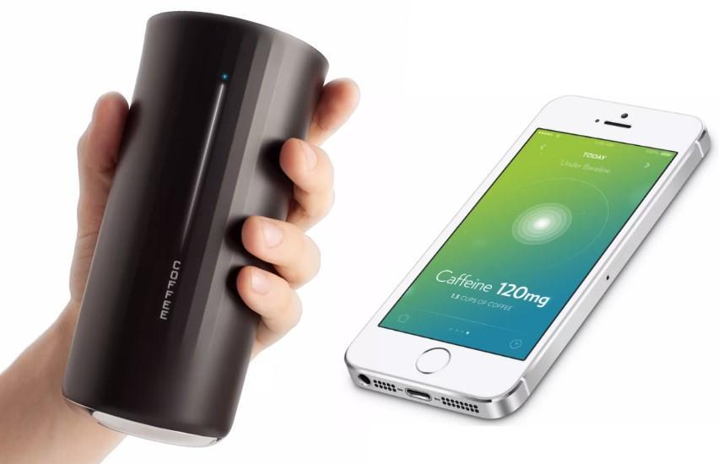
Current Technologies: Vessyl
Smart Cup → amount of liquid, type of beverage
Information on the side
Mobile app track every sip
Turns blue → Hydration
Only track water
Fig.3. Vessyl smart cup [2]

Slide 13
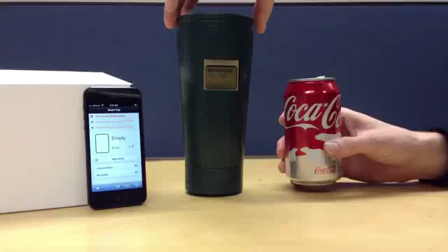
Current Technologies: Berkeley
Smart cup → track the consumption of common beverages
No detection of spoilage
LED on one side with sensor on the other side
Force resistor on the bottom of the cup
Wireless device in the base
App in mobile device

Slide 14
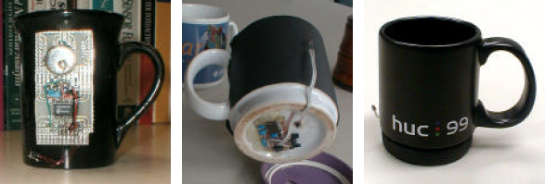
Current Technologies: Media Cup
Coffee Cup → Represent the context information: Location, Temperature
Components
Acceleration sensor
Microcontroller
Infrared diode
Lithium Battery
Semiconductor chip
Overhead Transceiver
Fig.4. Media cup Prototypes [3]
Notes:
first version→ for initial data collection but was not fit for day-to-day use.
second prototype→ embedded the MediaCup hardware at the bottom of a coffee cup.
third prototype → the hardware mounted in the rubber base of the HUC99 coffee cup, allowing removal so that the cup can be dishwashed.

Slide 15
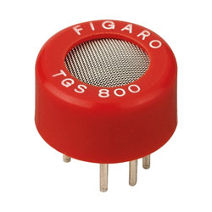
Option 1 Gas sensor
Use of a gas sensor TGS 800
Closed measuring chamber
Power Supply
Voltmeter
Fig.5. TGS 800 sensor [8]

Slide 16
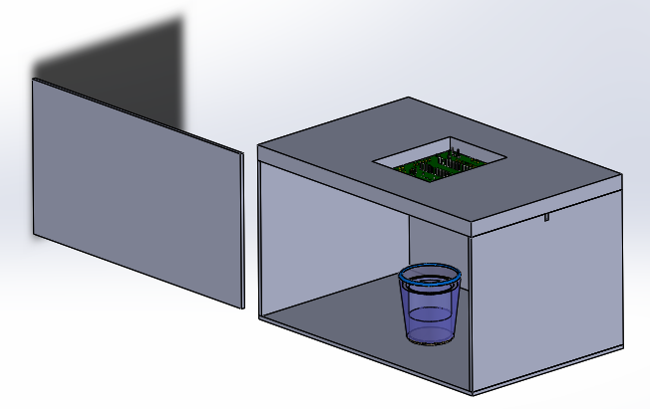
Option 1 Gas Sensor
Fig.6. Isometric View Enclosed Glass Box [9],[10]
Drawing assembled by Vanessa.M

Slide 17
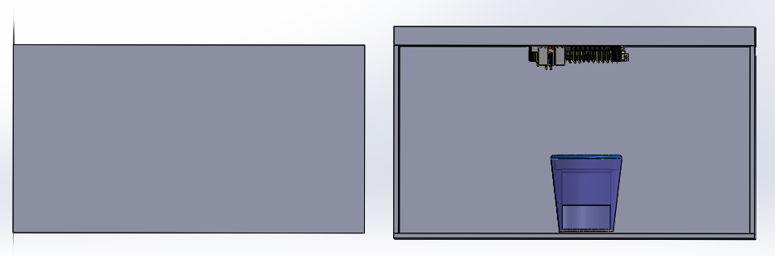
Option 1 Gas Sensor
Fig.7. Front View Enclosed Glass Box [9],[10]
Drawing assembled by Vanessa.M

Slide 18
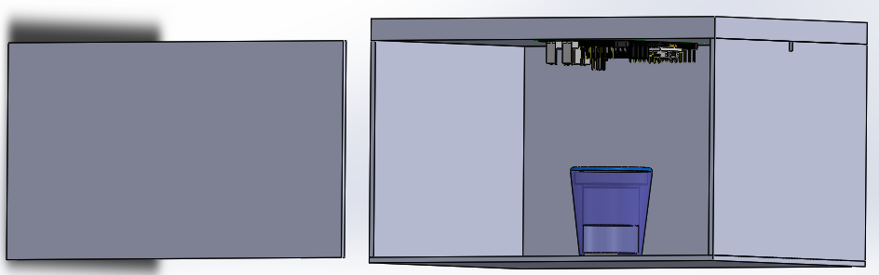
Option 1 Gas Sensor
Gas Sensors
Hole for Wiring
Polymer
Glass
Spoiled Milk
Fig.8.Detailed View Enclosed Glass Box [9],[10]
Drawing assembled by Vanessa.M

Slide 19
Conclusion
Purpose/ practicality or ease of use
- Easy set up, insert pH probe into spoiled milk and stir
Functionality
- Detects sour milk with a pH level of lower than 6.6
Features
- Noise alert when pH level is lower than threshold
General aesthetics
- Needs to be further improved to include all components under one housing
Potential of marketability
- Could potentially be commercialized

Slide 20
References
[1] Sung-Yueh Wu et al. 3D-printed microelectronics for integrated circuitry and passive wireless sensors in Microsystems & Nanoengineering, USA,2015
[2] http://hiconsumption.com/2014/06/vessyl-smart-cup/
[3]Hans-W. Gellersen et al. The MediaCup: Awareness Technology embedded in an Everyday Object in Telecooperation office, Karlsruhe, Germany, 2001
[4] Alicyclobacillus spp. Control in the Fruit Juice Industry
[5] Microbiology of soft drinks and fruit juices (P. Wareing and R.R.) Davenport
[6] http://dairyprocessinghandbook.com/chapter/chemistry-milk
[7] Shinde Kajal P. et al IoT based detection of microbial activity in raw milk by using Intel Galileo Gen II in IRJET, india, 2017.
[8] https://ciiva.com/part/tgs-800-13645760
[9] https://grabcad.com/library/circuit-board-pcb-mock-example
[10] https://grabcad.com/library/agian-glass-1

